Slide 1

Highlands Elementary
Stage 2 Return to School Protocols
Parent Presentation – August 31st, 2020

Slide 2
Introduction
School supports students in developing their potential and acquiring the knowledge, skills, and abilities they need for lifelong success.
In person learning provides the opportunity for peer engagement and fosters social and emotional development.
Based on the latest research from the PHO, children are at a lower risk of developing and transmitting Covid 19, K-12 students can return to full-time, in-class instruction.
The Ministry of Education has provided an investment of $45.6 million to support the implementation of enhanced health and safety measures.

Slide 3
Ministry Guidelines – Learning Groups and Physical Distancing
What is a learning group?
Why learning groups?
Maximum sizes
Interacting Inside and Outside of Learning Groups

Slide 4
Learning Groups at Highlands
We have 11 classrooms arranged into five separate learning groups.
  Our learning groups are made up of two or three classes combined – all groups are well below the ministry guideline of 60 students (including staff)
  We are minimizing the number of adults that interact with the learning groups (we are scheduling Education Assistants, TTOCs)
  Avoiding physical contact will be a priority in these learning groups.
  Staff outside of a learning group must practice physical distancing when interacting with learning groups (speech language pathologist, Student Services, etc.) When unable to practice physical distancing, other measures will be used.
  Questions?

Slide 5
Ministry Guidelines – Cleaning and Disinfecting
Remove and limit the use of shared equipment and frequently used items that are difficult to clean when practical to do so.
Frequency: General cleaning and disinfecting will happen at least once in a 24 hour period. High touch surfaces (for example, doorknobs, bathrooms, computers) will be cleaned at least twice in a 24 hour period, and at least once during regular school hours.

Slide 6
Highlands Enhanced Cleaning Protocols
Additional custodial time and support has been added to our school (to include daytime custodial services).
Staff are being oriented regarding these enhanced cleaning protocols and expectations in the classroom.
Students will be taught about their role in maintaining a healthy and clean Highlands Elementary
Questions?

Slide 7
Handwashing and PPE
Hand hygiene – hand washing is the most effective way to prevent the spread of Covid 19. We have to facilitate regular opportunities for staff and students to practice hand hygiene.
Non-medical masks are not recommended for elementary school students.
Staff are required to wear PPE in high traffic areas and where physical distancing cannot be maintained.
Wearing a mask, by staff or students, is a personal choice that will be supported.

Slide 8
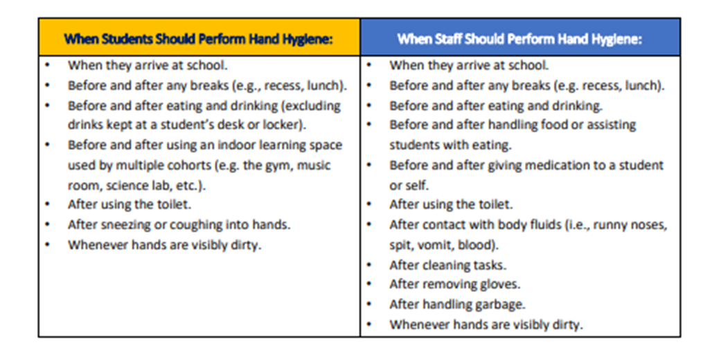
Highlands Hand Hygiene Protocols

Slide 9
District Guidelines - Transportation
Enhanced cleaning and disinfecting procedures are in place for busses.
Bus drivers will sanitize their hands before and after trips and use PPE, especially when loading and unloading students.
Student line ups will maintain physical distancing requirements.
Bus students will be seated according to family or learning group, and will be physically distanced when possible.
Elementary aged students are not required to wear masks on the bus.
We are encouraging parents to drive their children to school to prevent overcrowding on the bus, when possible.

Slide 10
Parent Responsibilities
Daily Health Checks – parents are expected to do a daily health check with their children (parents will be provided with a daily health check form – one signed copy to be returned to the school)
If a child displays any of the symptoms on the health check list, they must stay home.
Parents must stay outside of the building during drop off and pick up. Parents must also maintain social distancing at those times.
We are encouraging parents to send lunches that do not require heating, in containers that are easy for students to open. All recyclables will be sent back home with students.
Questions?

Slide 11
Visitor Access
Visitor access will be prioritized to activities that benefit student activities and well being (for example, public health nurses, meal program volunteers, etc.)
Visitors must make an appointment to meet with staff or administration.
Virtual meetings will encouraged, rather than face to face.
Visitors must complete a health check and sanitize their hands before entering for their appointment.

Slide 12
Curriculum and Activities
All curricular programs and activities will continue to operate within the enhanced health and safety protocols (including electives).
Communicating student learning will continue.
Field trips are still possible.
Inter-school sports cannot happen at this time.
Playgrounds remain open.

Slide 13
What Happens If a Child or Staff Member Gets Sick?
Refer to the following slide:

Slide 15
Thank You!
Thank you for taking the time to attend our parent information night. We hope that we have answered all your questions, but if not, please contact us through phone or email.
This may be a challenging year, but if we work together we are confident that Highlands students will have a positive experience and grow as learners and individuals!
We are excited to welcome our students back to school this fall!

