Slide 1
Laurie Middle School
Growth Plan 2023-2024
Year 3 Principal: Aaron Thorn
Vice Principal: Dave Doll

Slide 2
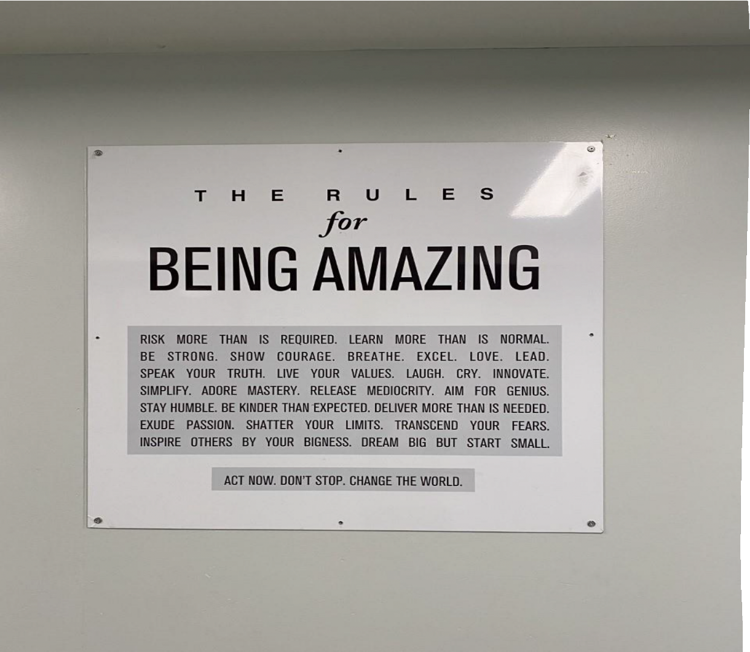
Thank You to Our Stakeholder Groups. . .
Our growth plan was created with the input and insights of the following stakeholder groups:
The staff of Laurie Middle School
The Student Services Department
The Math Department of LMS
The Indigenous Education department (Faye O’Neil, Mary Elliott, Nick Richards)
Ruby Kozicky (PAC President LMS)

Slide 3
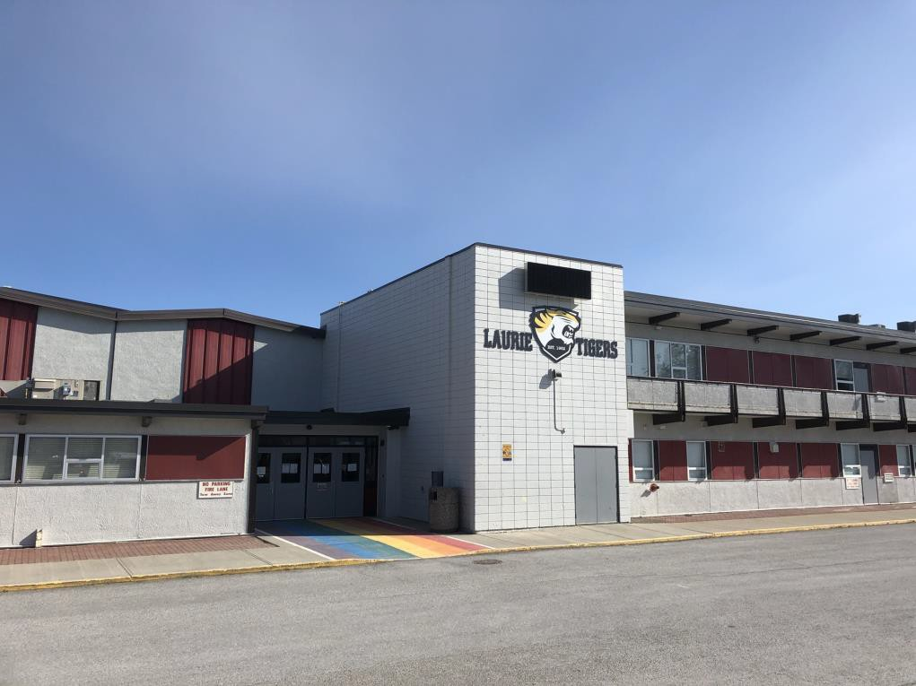
About Laurie Middle School . . .
•

Slide 4
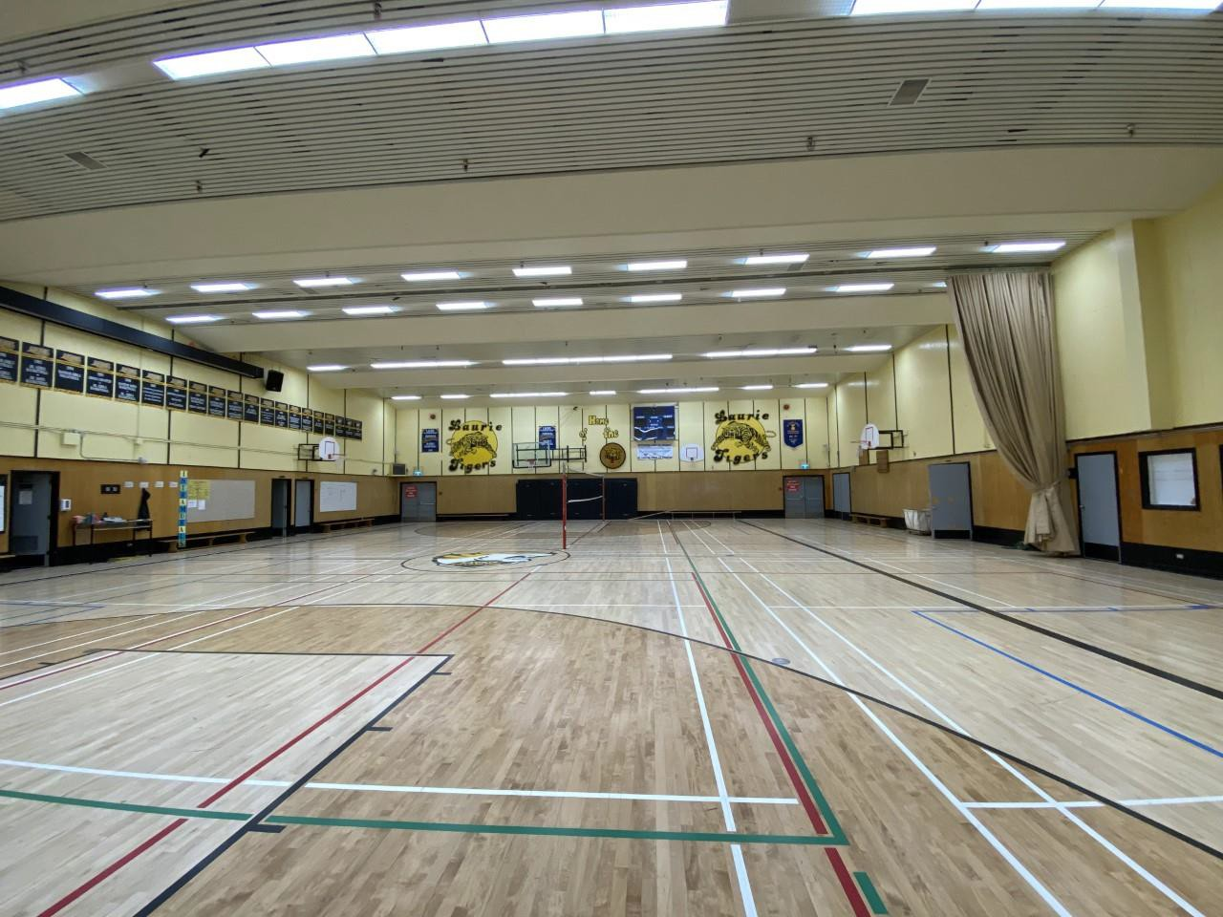
About Laurie Middle School . . .
Laurie Middle School has a full scope of elective courses, two NEST classes in grade 8 doing place based education, proximity to parks, recreational spaces, the community forest, and competitive and recreational sports teams.
We support our kids in a variety of ways using our YCW space, our drop in Learning Center, a large student services team, our Distance Learning Space, the Indigenous Education Room, the gym, and Counselling Space. These spaces are staffed fulltime and open all day to meet the various needs of our diverse group of students.
,

Slide 5
What We Stand For … Priorities at LMS
We are always exploring ways to get better, to increase student engagement, and to find paths to greater success for our students.
Our goals for 2023 – 2024
Goal #1 – Numeracy
Goal #2 – First Nations Principles of Learning and Indigenous Education

Slide 6
Educational Goal Outcome #1 - How can we continue the process of increasing numeracy results for our students and ensure they are better able to transition to the high school successfully?
•

Slide 7
Strategies . . .
•
•
•
Creation of Grade 7/8 Numeracy classes that pull kids in to work on grades 4-7 skills during electives (2023/24 Change)
•

Slide 8
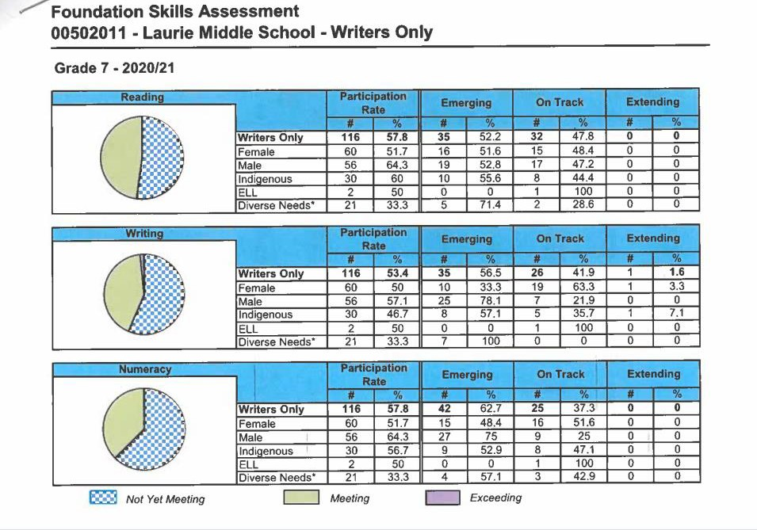
Examining the Data – FSA Results (2020-2021)
Data from the 2020-2021 year showed a participation rate of 57.8% for both the reading and numeracy portions of the FSA, with a slight decrease in the written portion of 53.4%.
The data shows more students in the “emerging” column than “on track.” The goal from 2020-2021 was to increase participation and move the needle on students from “emerging” to “on track” and into “extending” keeping in sight our focus on numeracy.

Slide 9
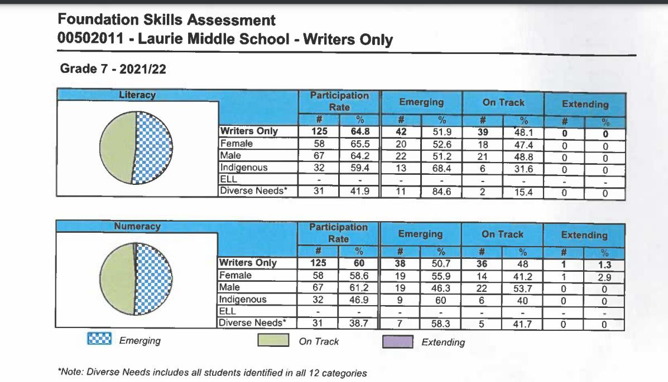
Examining the Data – FSA Results (2021-2022)
Data from the 2021-2022 year shows a significant
increase in the participation rates on the FSA.
Participation in the written section improved from 57.8% to 64.8%.
Participation in the numeracy portion increased
from 57.8% to 60%.
The needle was also moved on the number of
students who moved into the “on track” column.

Slide 10
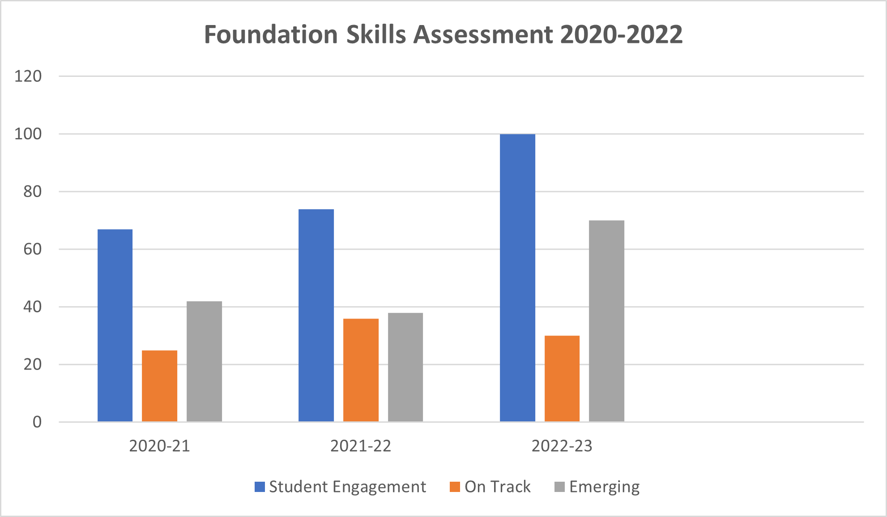
The data shows an increase in engagement from 67 students in 2020-21, to 100 students in 2022-23 (an increase of 33% over the course of three years).
This increase in engagement has revealed that there are more struggling students than we had originally identified. When you shine a light in the darkness, you see more of the need for interventions.
The number of students who are "on track" has remained relatively stable over the three years.
The number of students who are "emerging" significantly increased with the higher number of students engaging in the FSA.

Slide 11
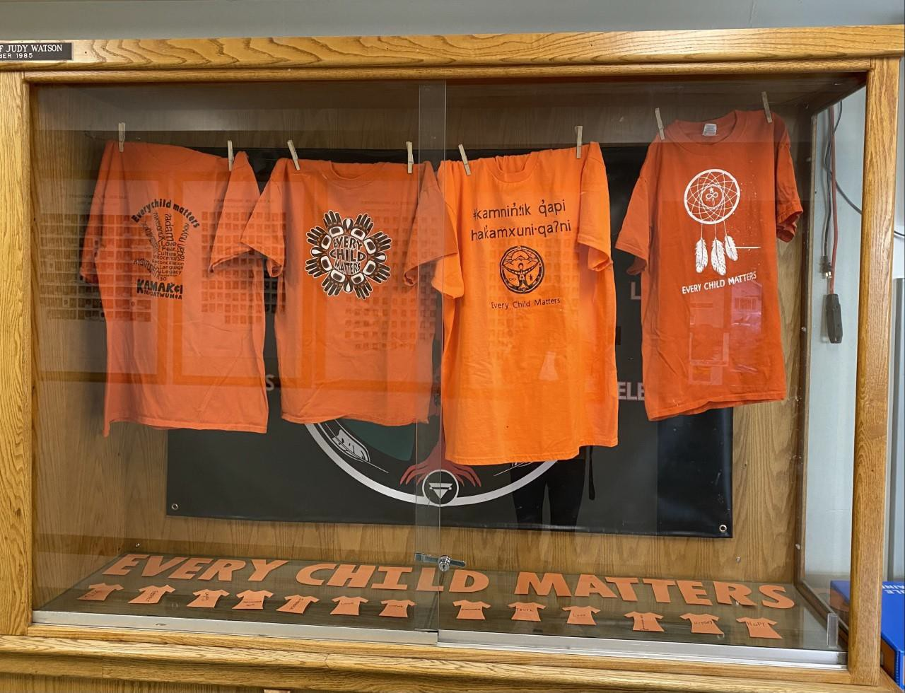
•
•
•

Slide 12
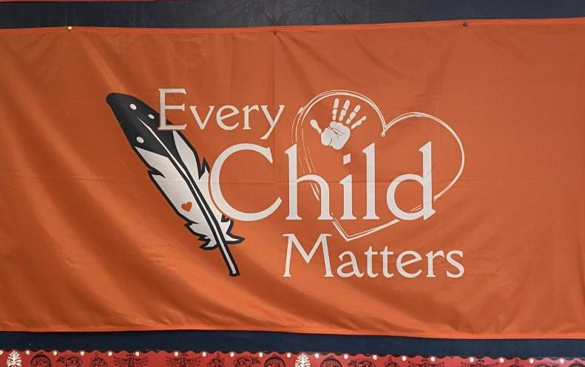
Strategies . . .
•
•
Year three of the growth plan has led to Nick Richards running the Distance Learning space which was designed with the support of our Indigenous Support staff. Currently there are 16 students registered and coming to school.
•
•

Slide 13
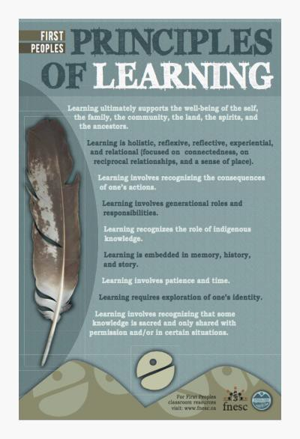
Check In – The First Nations Principles of Learning . . .
How are we designing classes, spaces, activities and supports while thinking about the descriptors found in the First People’s Principals of Learning?
Learning ultimately supports the well being of the self, the family, the community, the land, the spirits, and the ancestors.
Learning is holistic, reflexive, reflective, experiential and relational. (Focused on connectedness, on reciprocal relationships, and a sense of place)
Learning recognizes the role of indigenous knowledge
Learning involves recognizing the consequences of one’s actions.
Learning involves generational roles and responsibilities.
Learning involves patience and time
Learning requires exploration of one’s identity
Learning is embedded in memory, history and story
Learning involves recognizing that some knowledge is sacred and only shared with permission and/or in certain situations

Slide 14
Data . . .
Grade 7 Student Learning Survey – A Moment to Celebrate Success
Using data from the grade 7 learning survey we see an increase in student satisfaction in the following areas:
A sense of belonging to the school (up 5% from the previous year)
School is a welcoming place (up 1% from the previous year)
Students feel safe in the school (up 11% from the previous year)
We will use this metric, report card marks, and attendance to see how our Indigenous Education students are being engaged here at LMS.

Slide 15
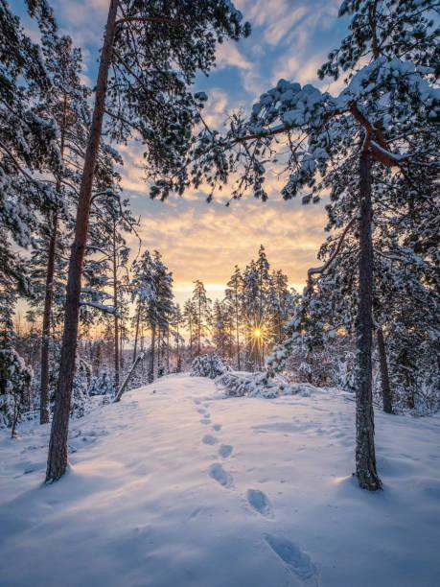
Next Steps:
•
•
•
•
•
•

